Slide 1

Puja Patel

Slide 2
Overview
Purpose of atKarma
Wireframes
How we would implement
Conclusion

Slide 3
Purpose of atKarma
atKarma is a social media and gaming integrated application
It is meant to encourage users to do good deeds for others
And to encourage users, they are awarded points for their services
“What comes around goes around”

Slide 4
Standard User Flow Using Wireframes

Slide 5
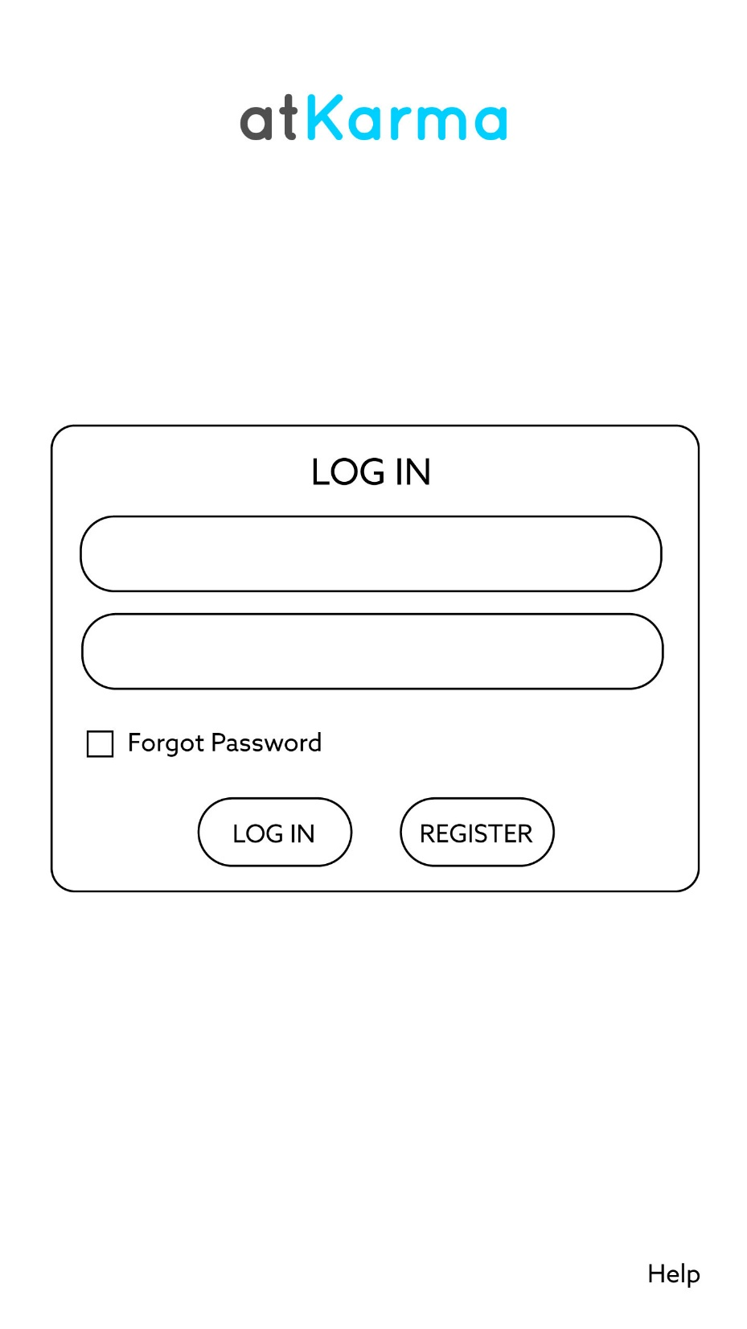
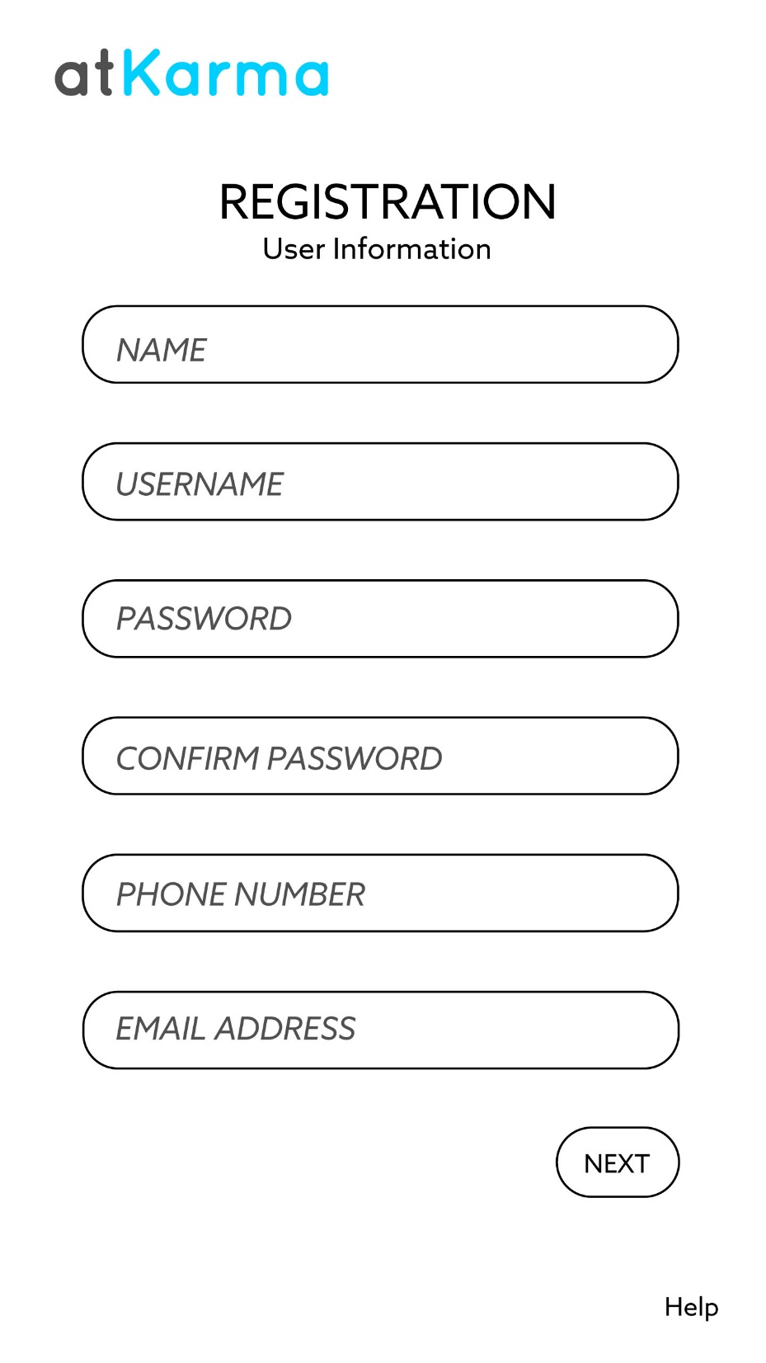

Slide 6
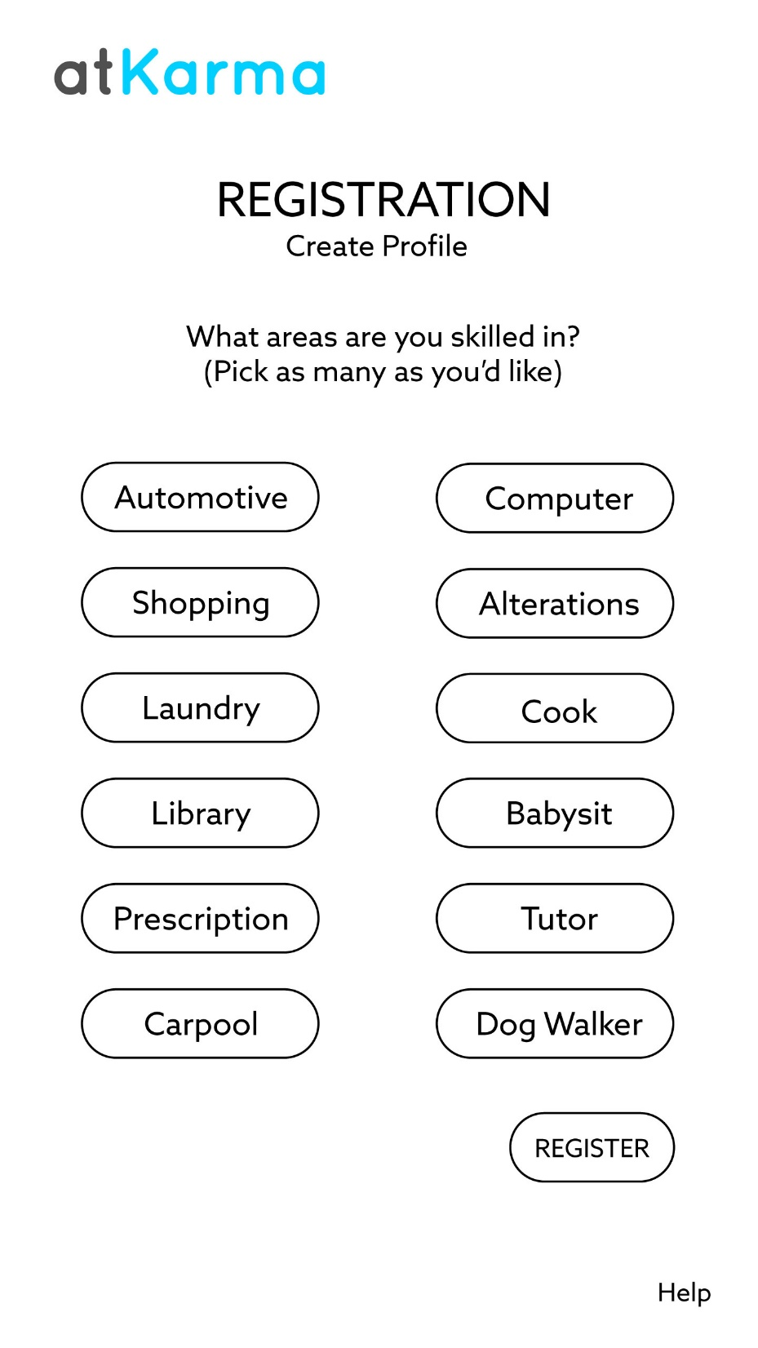
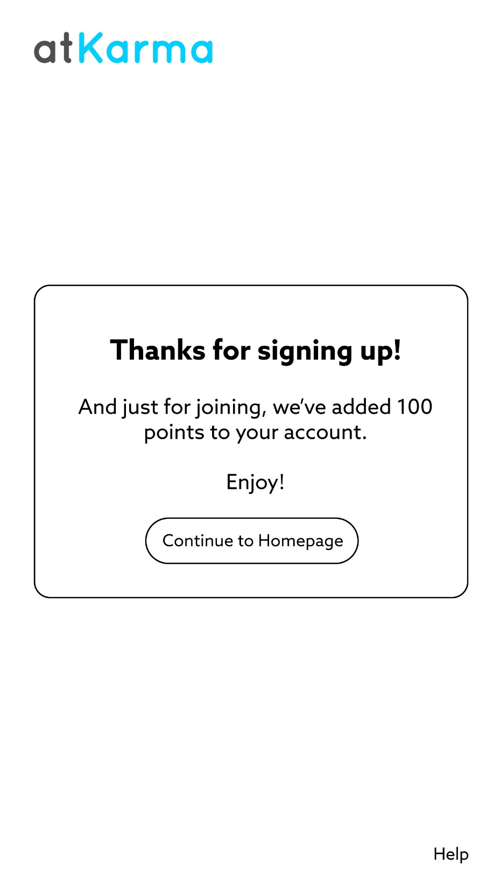

Slide 7
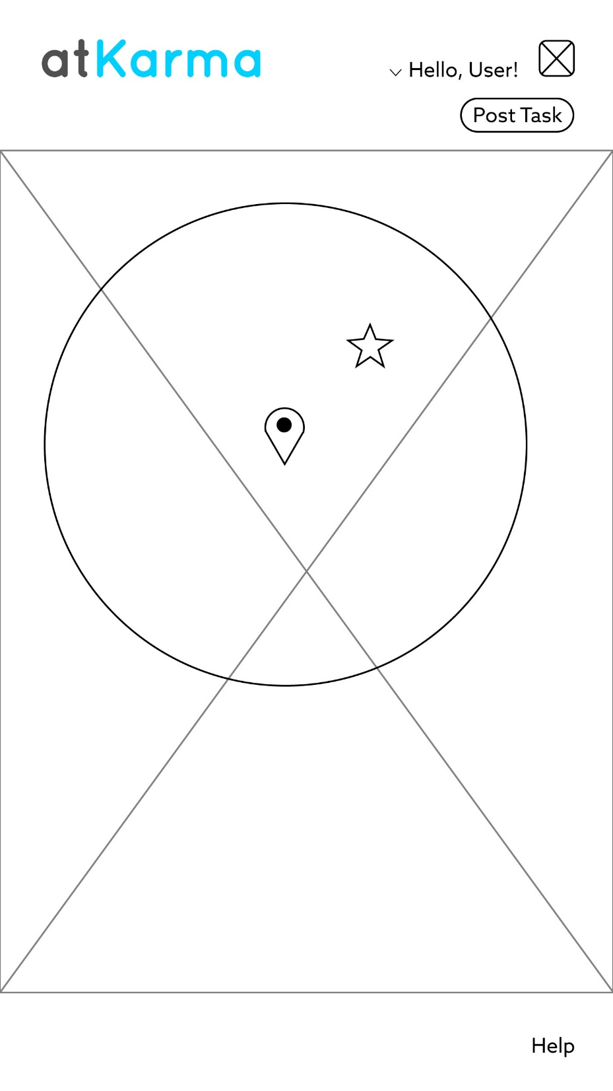
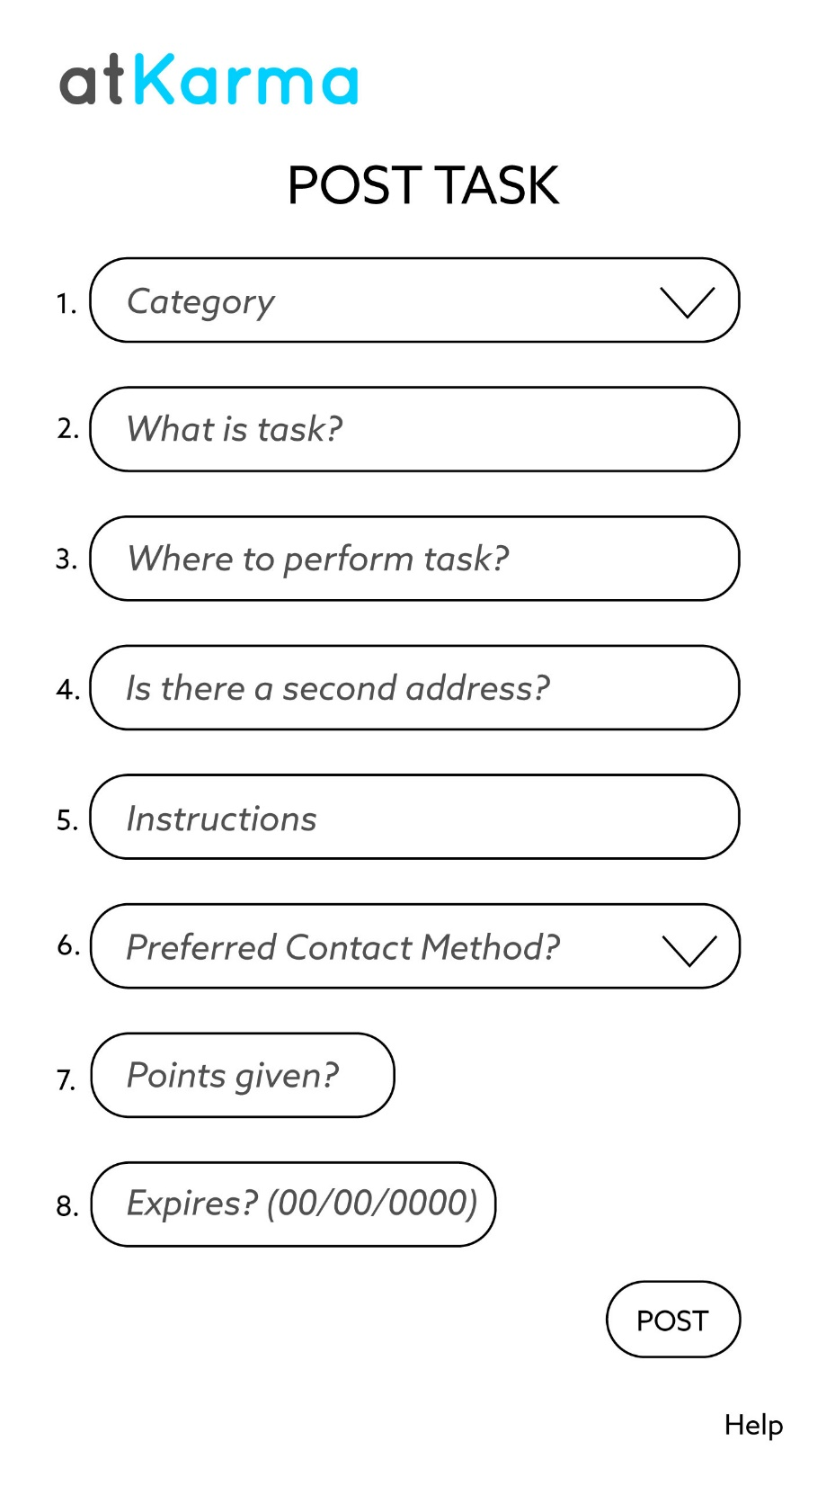

Slide 8
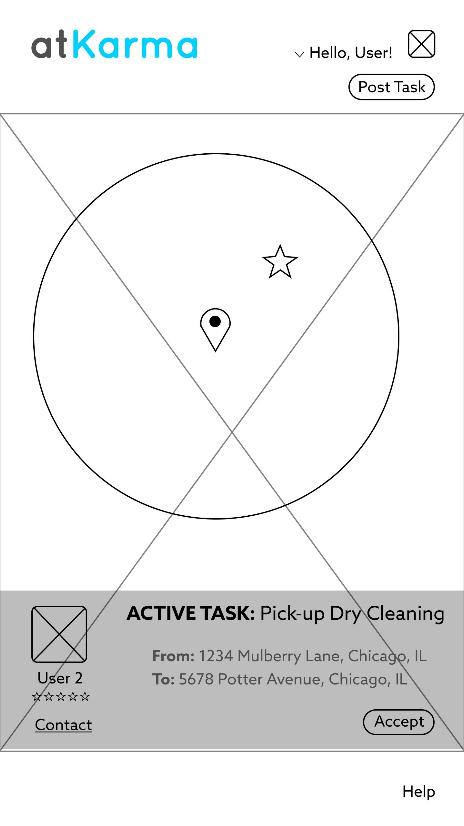
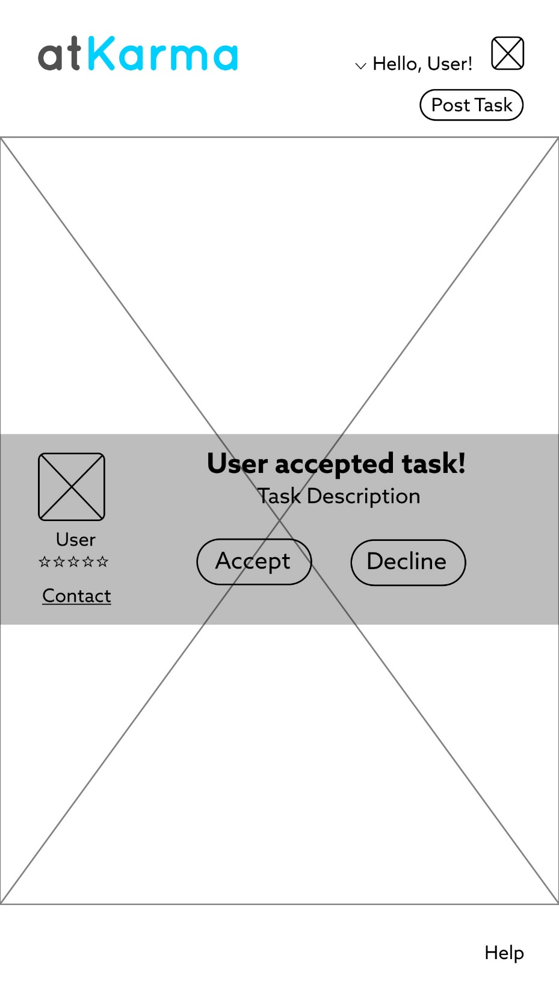

Slide 9
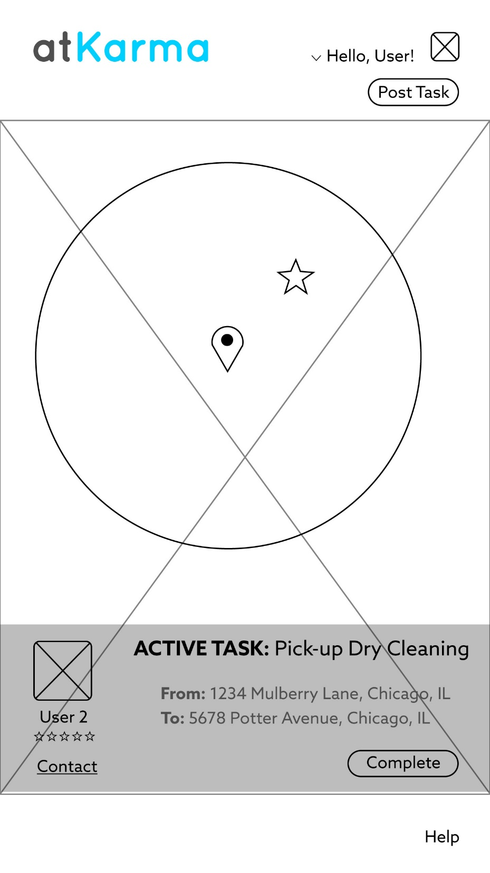
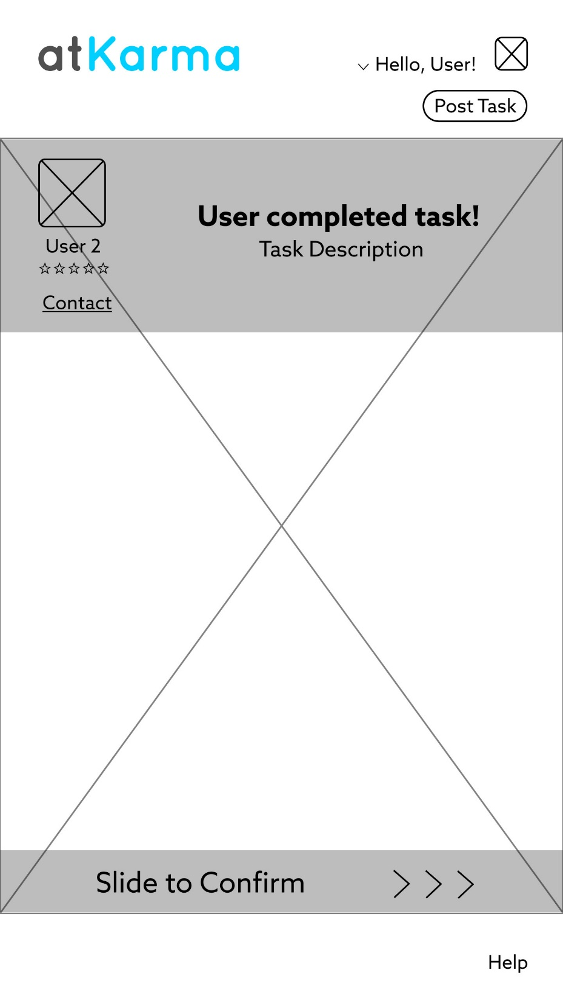

Slide 10
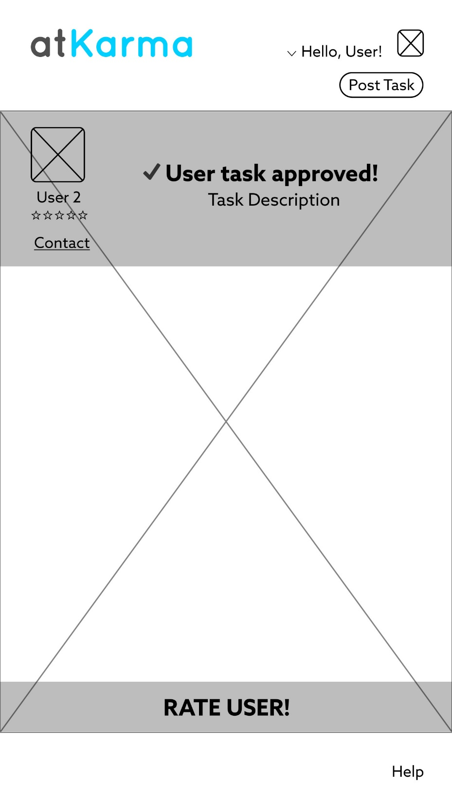
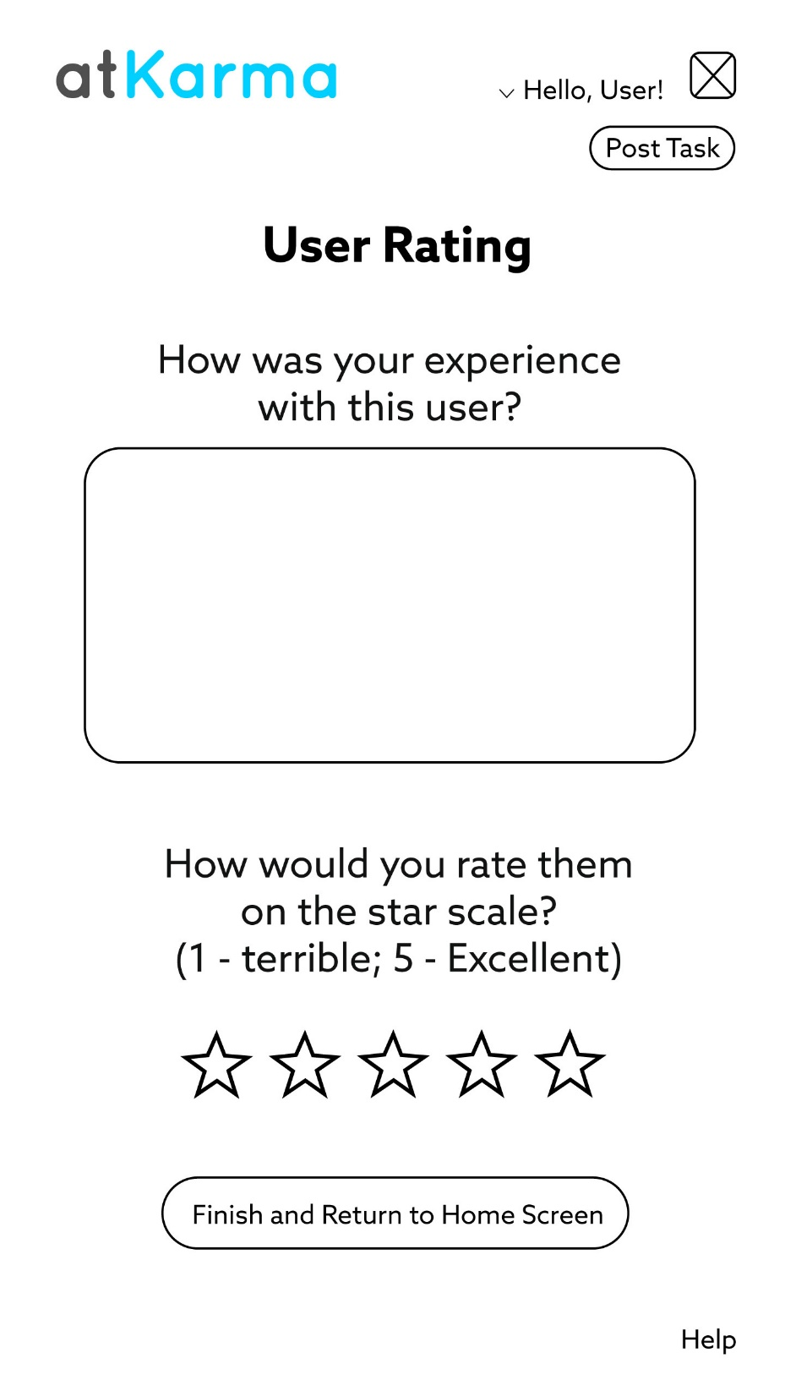

Slide 11
Rails 5.0
Rails 5 API complements Android.
Lots of directions we could have taken.
Created backend with Rails 5 API and SQL database.

Slide 12
Android
DEMO

Slide 13
Issues we encountered
Android can only do GET requests, and not POST
Limited our use with Rails API.

Slide 14
API Wishes
Users are able to input tasks they want to help others with. API.ai will be able to spot key words and search for specific tasks accordingly based on categorization.

